Slide 1

DEEP LEARNING IMAGE CLASSIFICATION
Project carried out by
RA1511018010203 – Madhu Korada
RA1511018010180 – Mullapudi Sree Pavan Teja
RA1511018010113 – Jay Jaju
Under the guidance of
Dr. R. Senthilnathan
Assistant Professor / Department of Mechatronics

Slide 2
Objective
This project deals with the field of computer vision mainly for the application of deep learning in object classification task.

Slide 3
Need of the project
To improve the application of computer vision using artificial intelligence evading the manual feature extraction process for object detection, etc.
By incorporating neural networks in vision system, we can enhance the performance and increase the accuracy of the system.

Slide 4
Literature survey
Author | Title | Proposed Methods | Journal, Year
Xinyi Zhou, et al., | Application of deep learning in object detection. | Proposed methods to classify objects using Faster R-CNN method. | IEEE Conference 24-26th May 2017
John D. Owens, Mike Houston, David Luebke, Simon Green, John E. Stone, and James C. Phillips | GPU Computing | Usage of General-purpose computing on the graphics processing unit (GPGPU). | IEEE Proceeding May 2008

Slide 5
Methodology
Firstly, we will access pre-acquired image datasets containing various images of fruits.
Since the training is a time expensive process, possibility of GPU computing in a standalone or in cloud compute engine would be used (tentative).
Then we would train our system with images using any one of the popular CNN architecture as proposed in the literature.
The training would be carried out with around 140 images in each class chosen randomly
The inference system would then use the remaining images in the dataset to validate the classification process

Slide 6
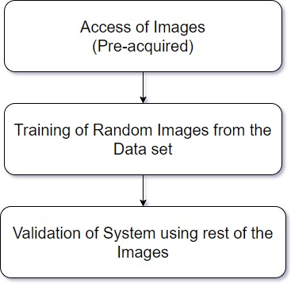
Overview of the project with block diagram

Slide 7
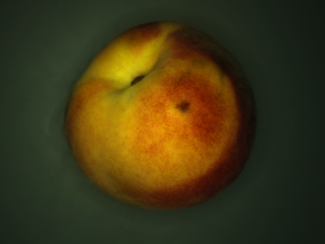
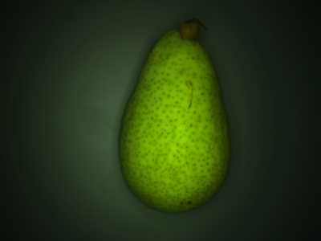
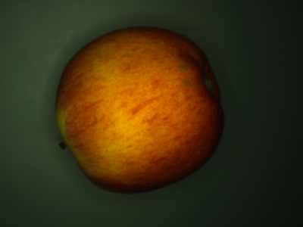
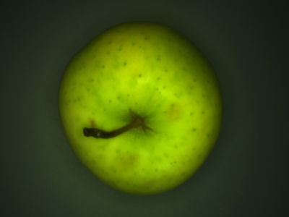
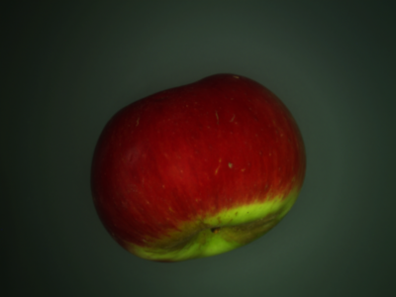
Classes Considered
Fruits
Apples
Peach
Pear
Braeburn
Golden
Topaz

Slide 8
Work plan (Till the last tentative submission date 30th April 2018)
Gathering of Datasets: Before 7th February.
Preparation of System Techniques: Before 21st February.
Presentation of the working model: 12th March.
Demonstration of the project: 30th April.

Slide 9
References
Xinyi Zhou, Wei Gong, Wenlong Fu, Feng tong Du, “Application of deep learning in object detection”, IEEE,16th International Conference on Computer and Information Science, May, 2017
Image courtesy: CIFAR 10

